Slide 1
Introduction to Linear Models

Slide 2
Association:
Association (relationship) tells us how each variable is related to the other variable(s).
Before fitting a linear model, it is important to check the association.

Slide 3
Scatterplot (Scatter Diagram):
The scatterplot graphs a pair of numerical (quantitative) variables, with one variable on each axis.
If some association exists, the data will tend to cluster around some line or curve that cuts through the plotted points.
A scatter plot can be used to help determine if an association is linear or nonlinear.
A scatterplot can indicate the direction of the relationship.
A scatterplot provides a visual revelation of outliers.

Slide 4
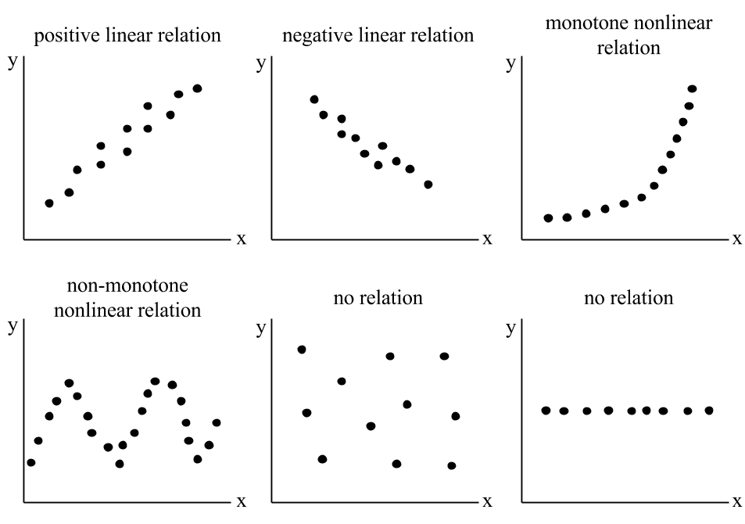
Figure 1 Describing Scatterplots

Slide 5
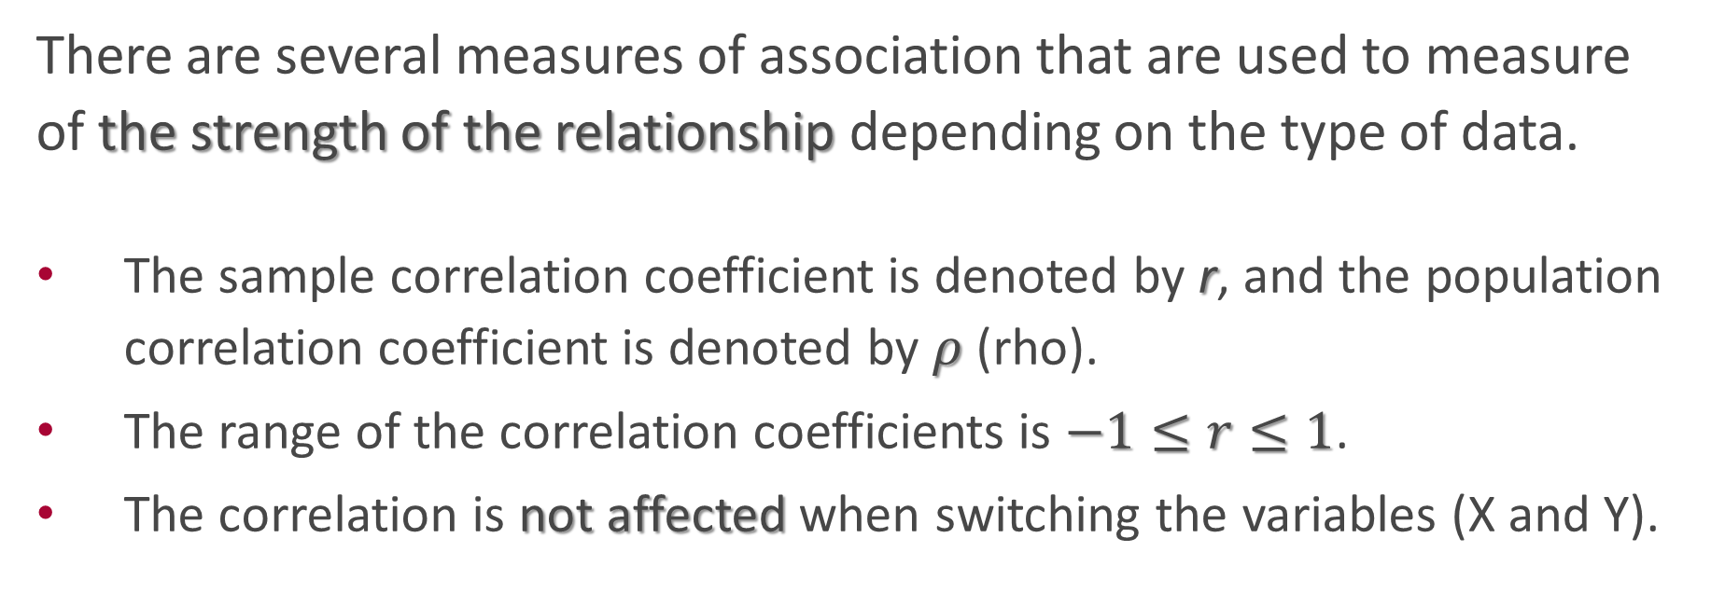
Correlation Coefficients (Measurements):
There are several measures of association that are used to measure of the strength of the relationship depending on the type of data.
The sample correlation coefficient is denoted by r, and the population correlation coefficient is denoted by $ρ$ (rho).
The range of the correlation coefficients is $−1≤r≤1$.
The correlation is not affected when switching the variables (X and Y).

Slide 6
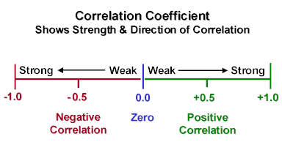
Figure 2 Correlation Coefficient Range

Slide 7
Common correlation coefficients:
Pearson Coefficient: It assumes that the variables are numerical, linearly related, and normally distributed (normality)
Spearman Coefficient: It assumes that the variables are numerical or ordinal, and the relationship is a monotonic relationship.
Kendall Coefficient: It is an alternative (non-parametric) for the Spearman coefficient with the same assumptions.
Phi Coefficient (𝜙): It measures the association between binary variables.
Cramer’s coefficient: It measures the association between multinomial variables (more than two categories).

Slide 8
Regression Analysis

Slide 9
Regression Analysis:
It is an approach to modelling the relationship between a numerical response (dependent, outcome, or target) variable and one or more explanatory variables (independent, predictor, or attribute) variables.
The case of one predictor is called simple linear regression.
The case of more than one predictor is called multiple linear regression.
The predictors can be numerical or categorical (binary which is coded as (0, 1)).

Slide 10
Steps of Regression Analysis:
Determine the response and predictor variables.
Check the assumptions.
Obtain a proper model.
Test the model.
Interpret the results.
Apply the predictive model.

Slide 11
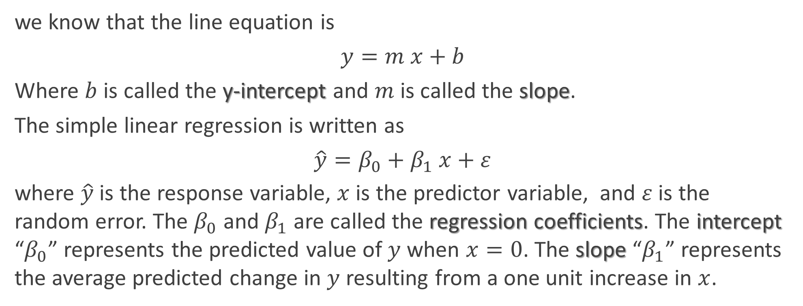
Simple Linear Regression (SLR):
we know that the line equation is
$$y=m x+b$$
Where $b$ is called the y-intercept and $m$ is called the slope.
The simple linear regression is written as
$$\hat{y}=β_{0}+β_{1} x+ε$$
where $\hat{y}$is the response variable, $x$ is the predictor variable, and $ε$ is the random error. The $β_{0}$ and $β_{1}$ are called the regression coefficients. The intercept “$β_{0}$” represents the predicted value of $y$ when $x=0$. The slope “$β_{1}$” represents the average predicted change in $y$ resulting from a one unit increase in $x$.

Slide 12
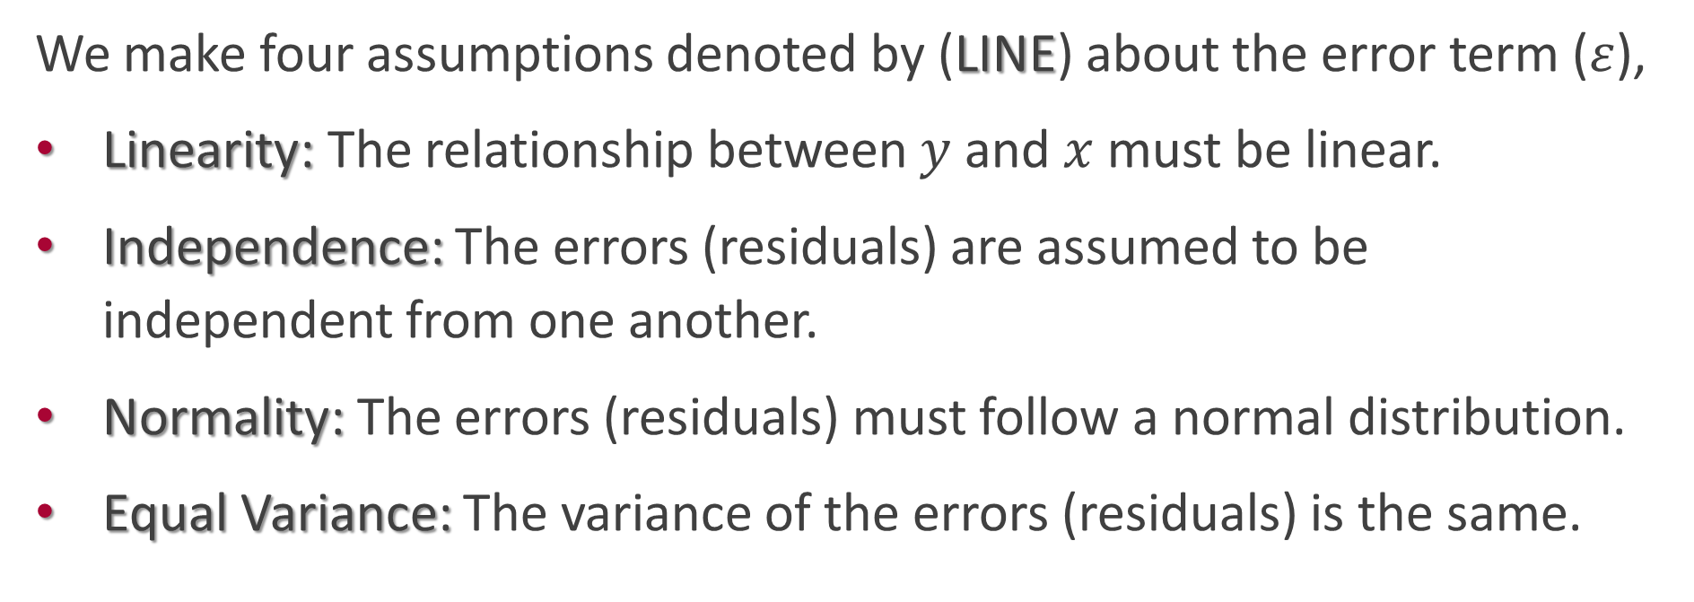
Linear Regression Assumptions:
We make four assumptions denoted by (LINE) about the error term ($ε$),
Linearity: The relationship between $y$and $x$must be linear.
Independence: The errors (residuals) are assumed to be independent from one another.
Normality: The errors (residuals) must follow a normal distribution.
Equal Variance: The variance of the errors (residuals) is the same.

Slide 13
Diagnosing Simple Linear Regression Assumptions:
Linearity : Use the observed versus predicted (fitted) values plot. The points should be randomly distributed around the horizontal line (0).
How to fix: Apply an appropriate transformation to the response or/and predictor variable such as a logarithm or square root.

Slide 14
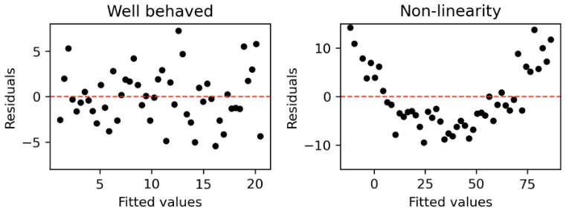
Figure 3 Checking the linearity assumption

Slide 15
Diagnosing Simple Linear Regression Assumptions:
Independence: Use the observed versus predicted (fitted) values plot, and check if there is a pattern. Run the Durbin-Watson test.
How to fix: Apply an appropriate transformation to the response or/and predictor variable such as a logarithm or square root.

Slide 16
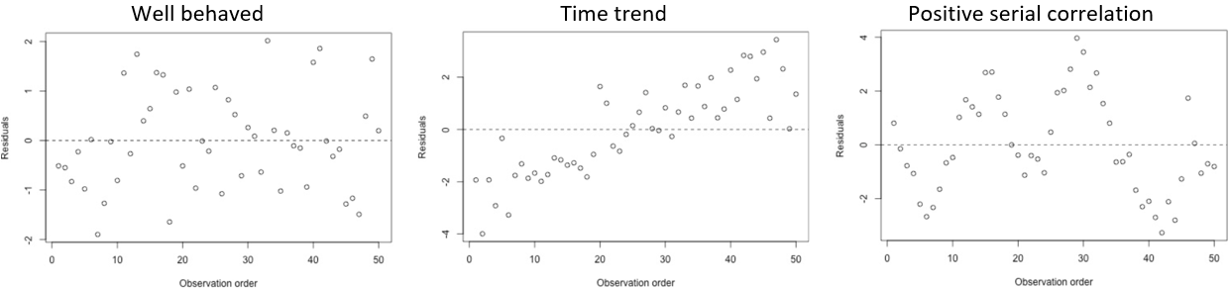
Figure 4 Checking the independence assumption

Slide 17
Diagnosing Simple Linear Regression Assumptions:
Normality: Check the QQ plot or histogram of the residuals, or run one of statistical tests such as the Shapiro-Wilk test.
How to fix: Apply an appropriate transformation to the response and/or predictor variable such as a logarithm or square root.

Slide 18
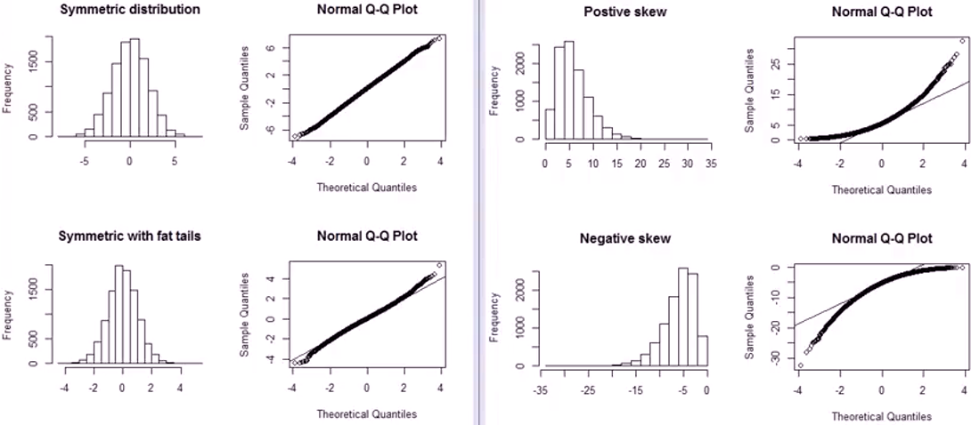
Figure 5 Checking the normality assumption

Slide 19
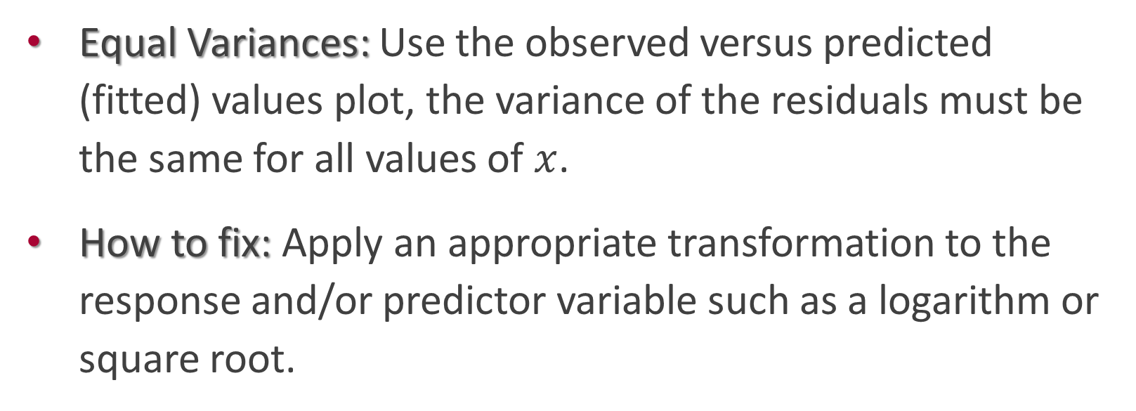
Diagnosing Simple Linear Regression Assumptions:
Equal Variances: Use the observed versus predicted (fitted) values plot, the variance of the residuals must be the same for all values of $x$.
How to fix: Apply an appropriate transformation to the response and/or predictor variable such as a logarithm or square root.

Slide 20
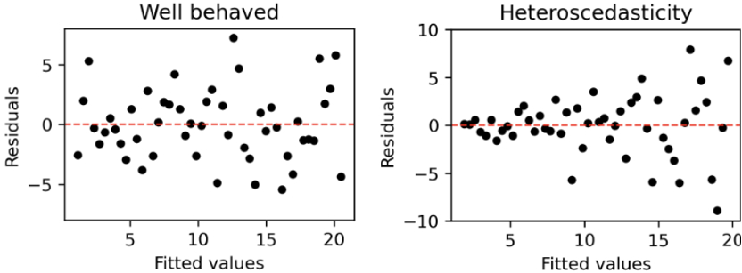
Figure 6 Checking the equal variance assumption

